Slide 1
Faculty Recruitments &
Reimbursement
Academic Personnel, College of Letters & Science, Business and Financial Services, UCOP Central Travel Management
December 10, 2019
Notes:
Introduce AP and L&S staff
This discussion is about the campus interview stage of the senate faculty search process.

Slide 2
Policies & Procedures
  APM 540
  BFB-G-28
  Red Binder VII-4
College of Letters & Science Recruitment Reimbursement
  Everything you need to know!

Slide 3
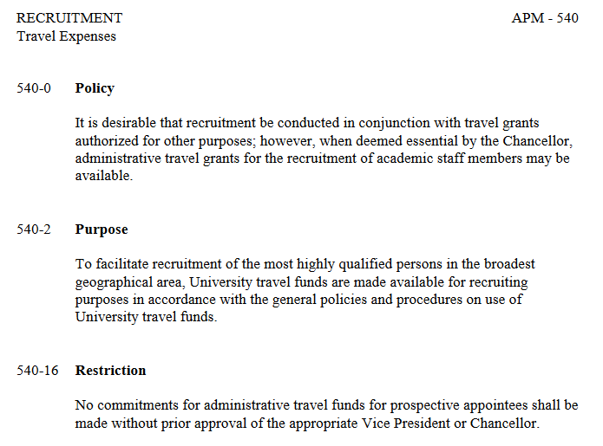
Policies & Procedures
APM 540
Notes:
This is the entire APM 540 policy – it basically says that administrative travel grants are authorized for recruitment of academic staff, that they are to facilitate highly qualified persons without geographical constraints, that they must be used in accordance with university travel policy, and that they are authorized by the Chancellor.

Slide 4
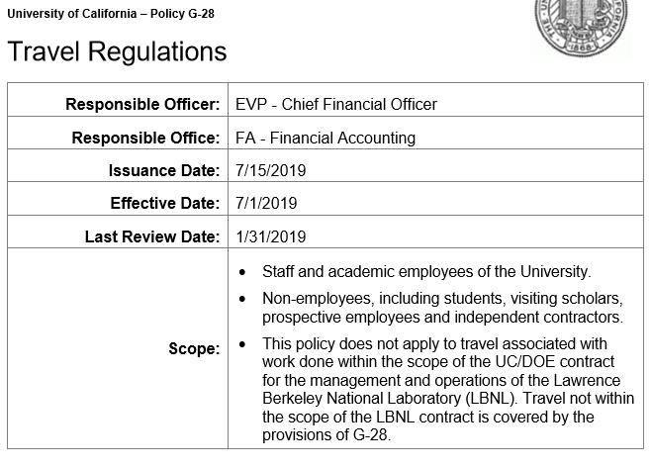
Policies & Procedures
BFB-G-28
Notes:
As they travel to the Santa Barbara area, prospective employees are on travel status, so policy and procedures of BFB-G-28 apply.

Slide 5
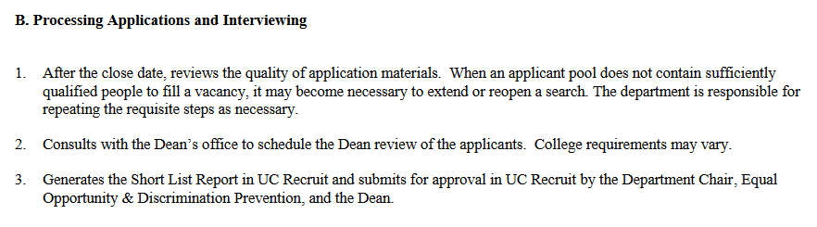
Policies & Procedures
Red Binder VII-4-B
Notes:
There is not a whole lot that the RB says about the recruitment process because the approach can vary by college or division and is governed more by the funding control point and UC travel policy.

Slide 6
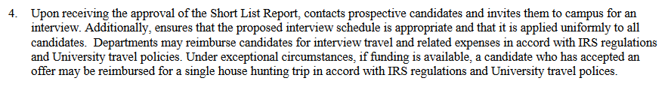
Policies & Procedures
Red Binder VII-4-B (cont’d)
      Approved Shortlisted candidates are to be invited
      Uniform equitable treatment for all candidates
      Follow University travel policies and IRS regulations
      House-hunting allowable by exception, if funding is available
Notes:
Step 4 of RB VII-4 has the essential elements of AP policy for this topic
- Approval of shortlist report via UC Recruit
- Equitable treatment: e.g. if one candidate is hosted for dinner, all should be; all candidates meet with the Dean if one candidate does, etc.
UC Policy: candidates can’t fly 1st class, should incur reasonable expenses, e.g. a limousine ride to airport so that the candidate can work on laptop is not as reasonable as a car-share ride via Uber or Lyft.
House-hunting may happen during second visit, for example. If funding is available, and if exception granted, then it’s possible to cover it as a reimbursable travel expense. Not payable via Removal funds if the candidate ends up being finalist.

Slide 7
Questions? AP Contacts
Helly Kwee – Sr. Analyst, Math, Life, & Physical Sciences; Engineering; ORUs; Bren
  x5428 helly.kwee@ucsb.edu
Lia Cabello – Sr. Analyst, Social Sciences; Academic Programs; Creative Studies; Educ; HFA
  x5979 lia.cabello@ucsb.edu
June Betancourt – Assoc. Director, Academic Recruitment, AP Training, general AP policy
  x5728 june.betancourt@ucsb.edu

Slide 8

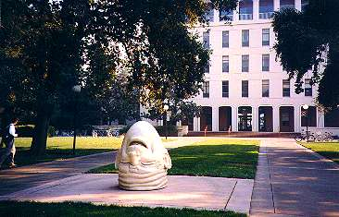
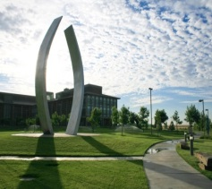


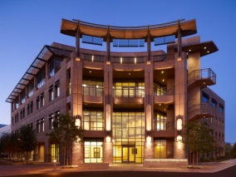

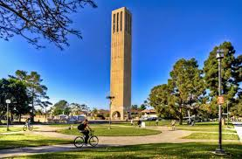
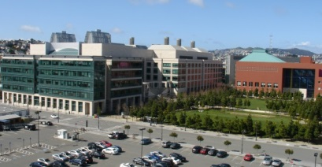
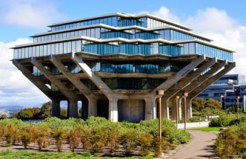
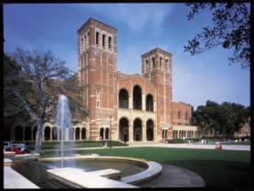
Why ConnexUC?

Slide 9
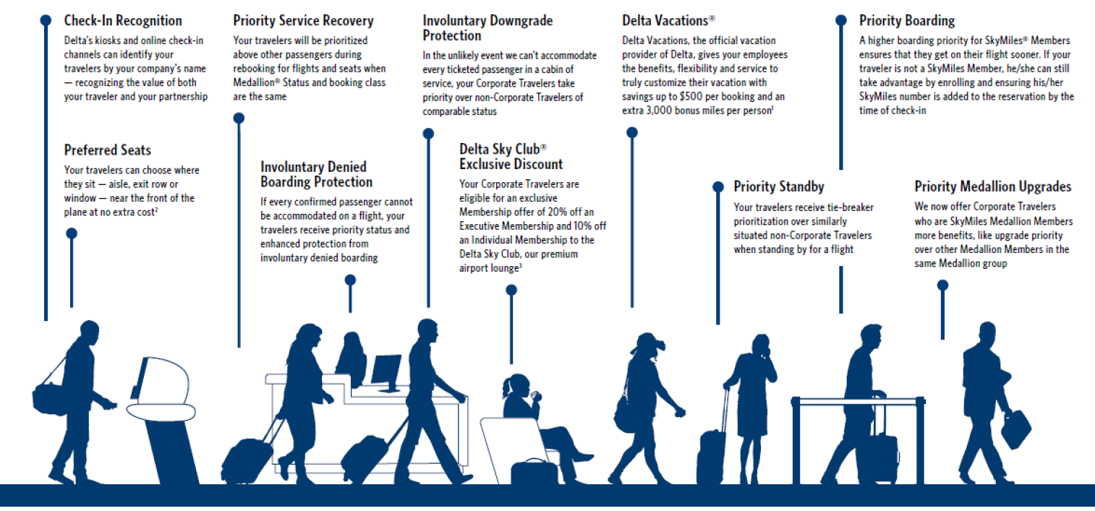

Involuntary Denied Boarding Protection
If every confirmed traveler cannot be accommodated, UC travelers usually receive priority status and enhanced protection
Priority Standby
UC travelers receive tie-breaker prioritization over similarly situated non-corporate travelers when standing by for a flight (AA, Delta/JV)
Priority Boarding
Higher boarding priority ensures that UC travelers get on their flight sooner. (AA, Delta+JV)
Alaska Airlines
Upgrades offered 90-minutes before departure (only on some California routes). 2500 upgrades in 2018
Hotel Program
Marriott Hotels (UC0);
Club Quarters;
Wyndham
Car Rentals
National, Enterprise Hertz, Dollar & Thrifty;
Rate includes CDW/LDW
Preferred Seats
UC travelers can choose where to sit (aisle, exit row, window) near the front of the plane - at no extra cost (Delta/AA)
Upgrades
UC travelers can request these for car rental class or hotel rooms only at the time of check-in
SWABIZ
50% EXTRA Rapid Reward points for tickets booked at SWABIZ
Benefits of Booking within UC Contract

Slide 10
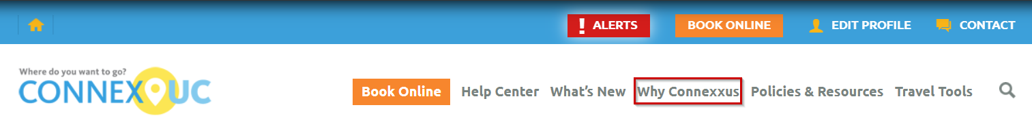
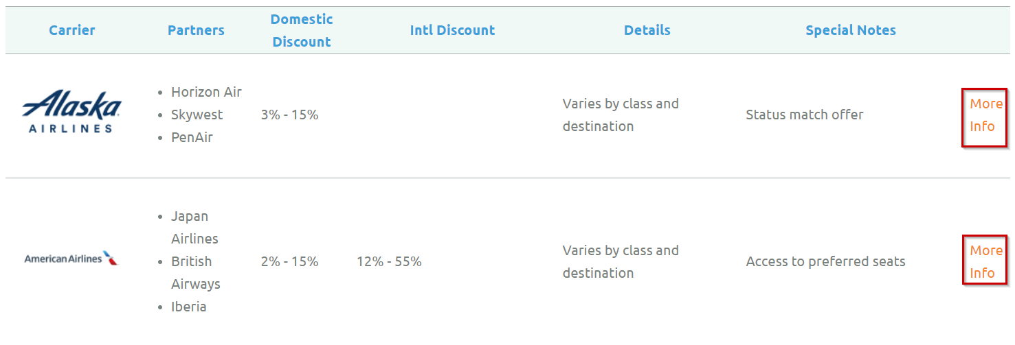
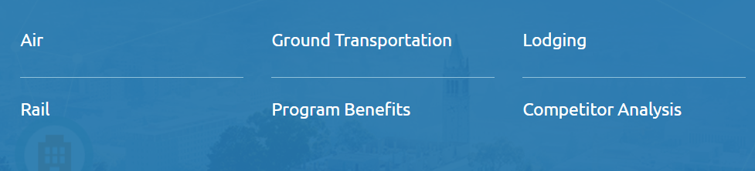
More info – travel.ucop.edu

Slide 11
Everything you need to know about reimbursement for recruitment expenses from the College of Letters & Science

Slide 12
Reimbursement for Faculty Recruitment
Faculty recruitment expenses for advertising and candidate travel, lodging, and solo meals should be charged initially to the departmental account. The fund number used by the College for reimbursing these expenses may change from year to year, so confirm which fund to use before charging faculty recruitment expenses.
Eligible expenses for three candidates per search, up to a total of $5K, will be reimbursed by the College of L&S.

Slide 13
and…
Travel must be in compliance with UC policies and procedures (see UCOP policy BFB-G-28.
Reimbursement cost-shares for searches between colleges (e.g., CCS and L&S) should be determined by the respective deans before the search begins.

Slide 14
When can I submit a reimbursement request?
Don’t wait until the end of the fiscal year to get your money back!
The department may request reimbursement from the College as soon as all eligible expenses have been finalized and receipts are in hand.
Reimbursements must be requested before the end of the fiscal year in which they are incurred.

Slide 15
What expenses are ineligible for College reimbursement?
Spousal travel
Alcoholic beverages
Faculty entertainment expenses with candidate (e.g., group lunches or dinners)
Second visits by candidate and/or spouse
House-hunting trips

Slide 16
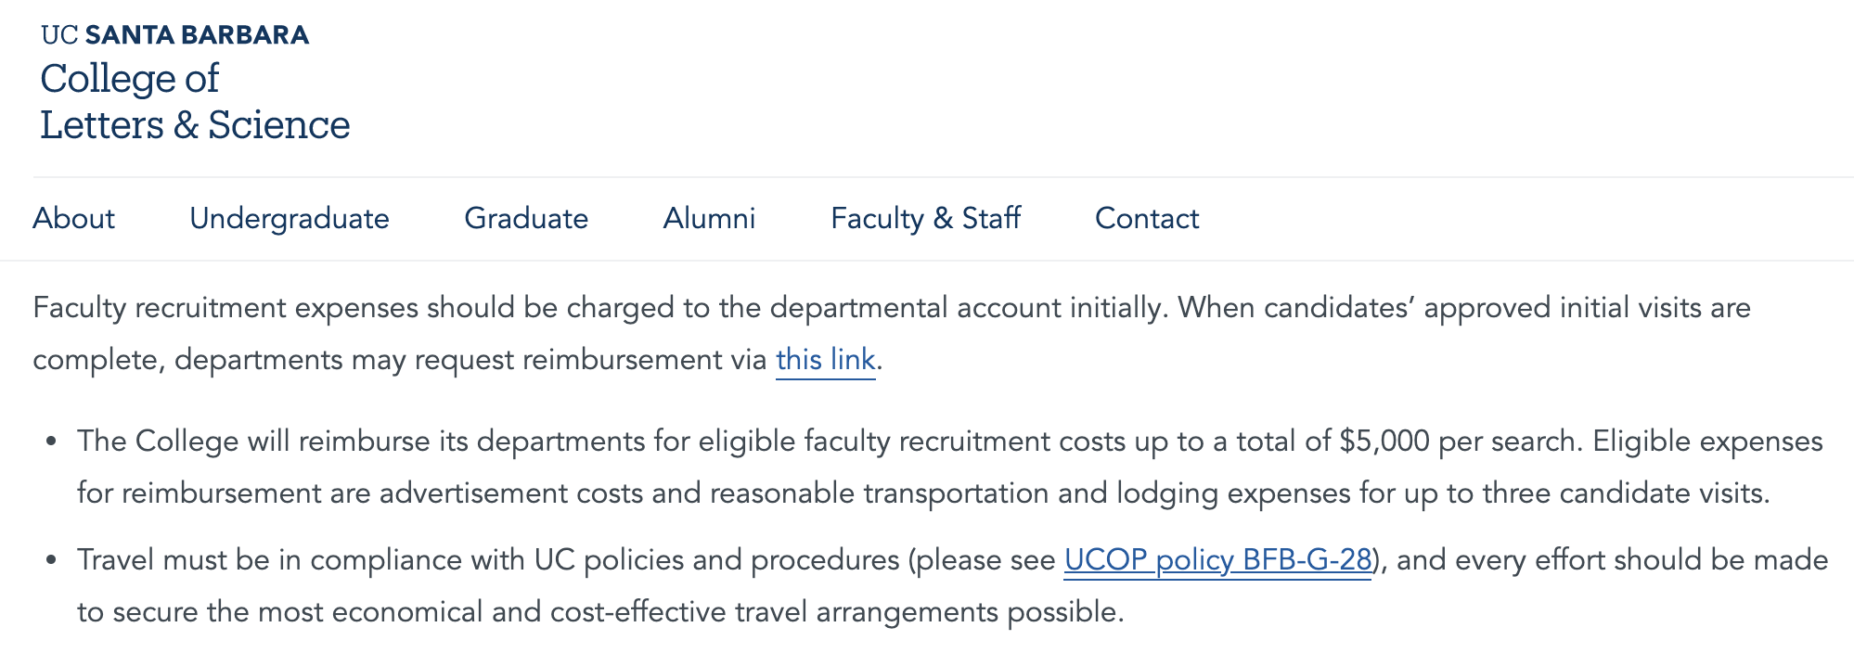
To request reimbursement, go to https://www.college.ucsb.edu/funding-financial-support; scroll to Faculty & Department Reimbursements, and Faculty Recruitment

Slide 17
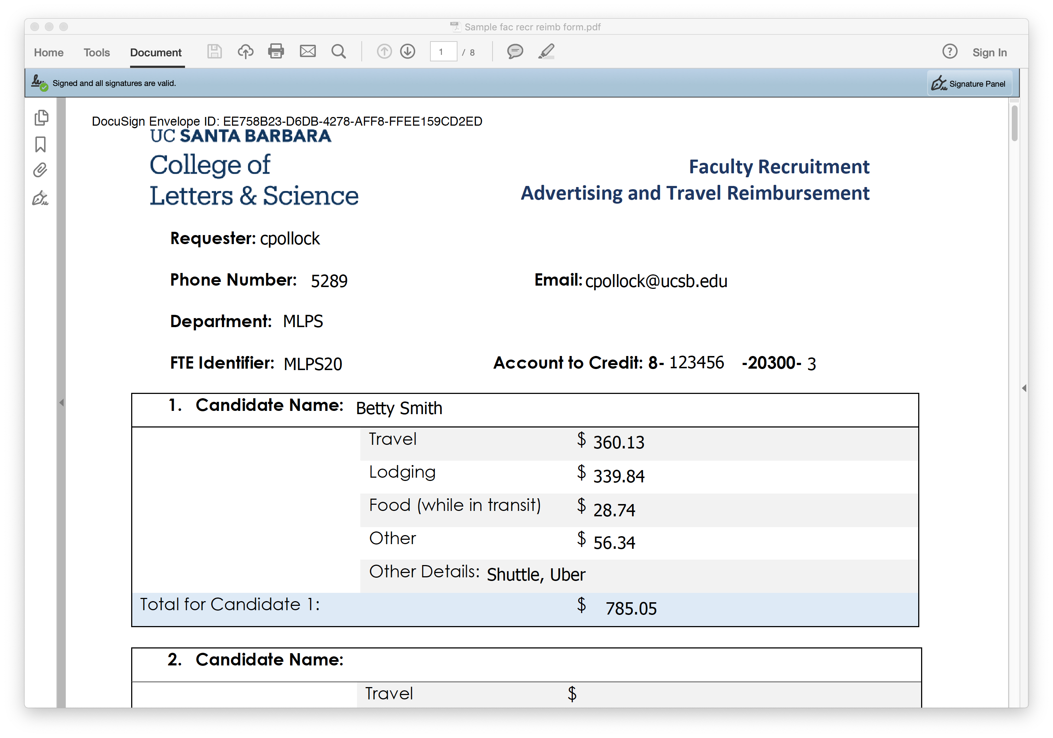
Enter your UCSBnetID and @ucsb.edu email address to access the DocuSign form. Complete all fields and enter eligible expenses for three candidates.

Slide 18
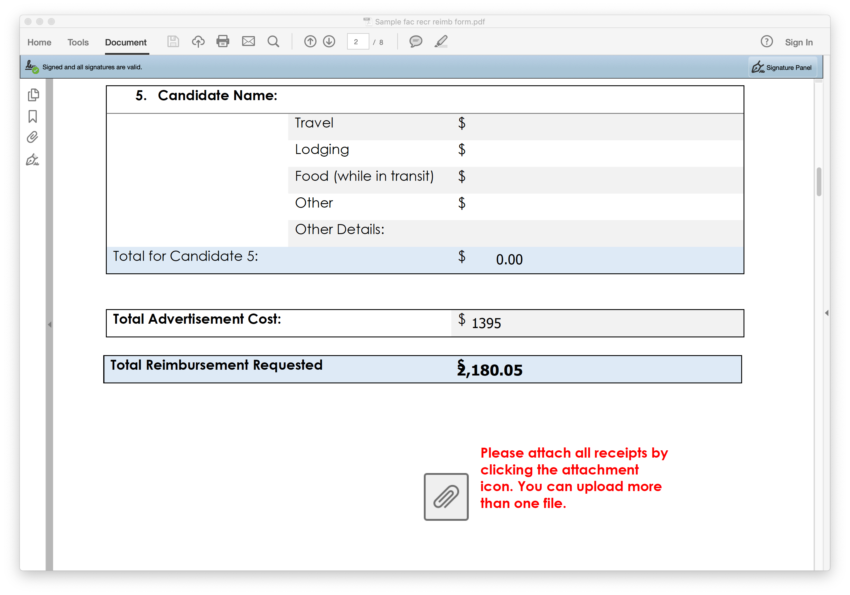
Add in search advertising costs, and the form will total all expenses. Click on paperclip to upload multiple receipts.

Slide 19
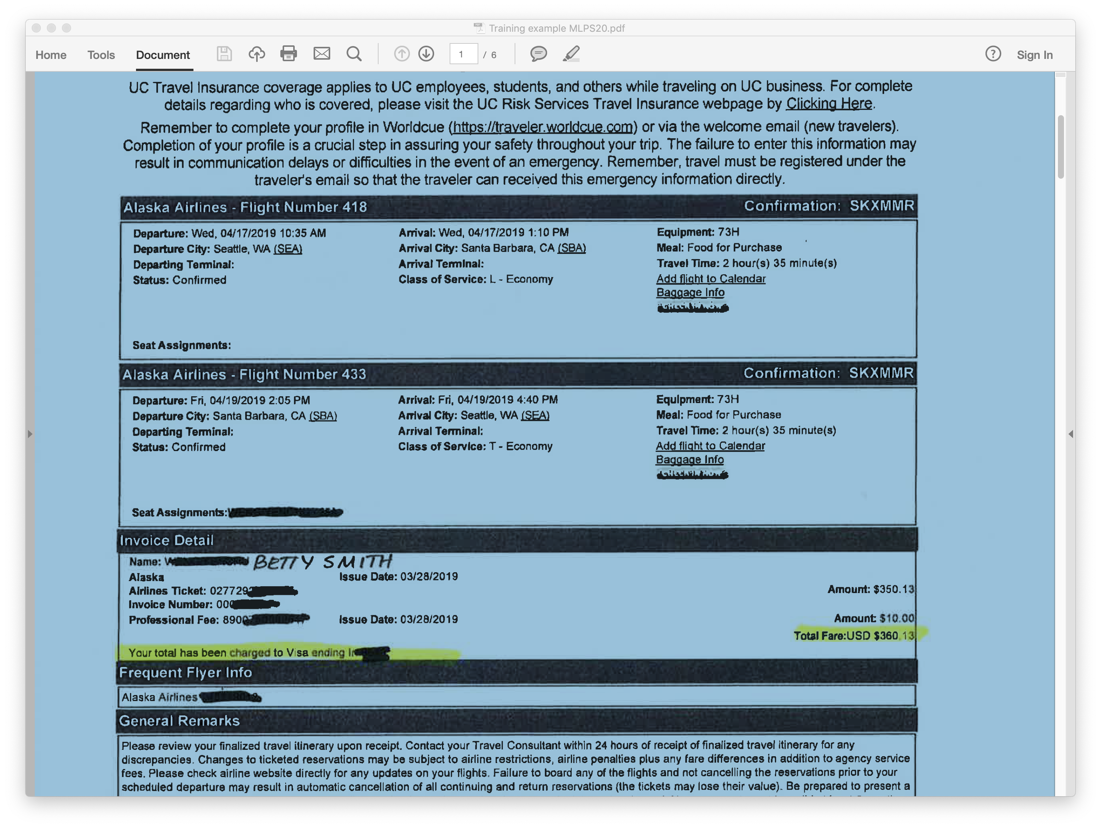
Save yourself time by uploading only one receipt per person per expense. For example, airfare…

Slide 20
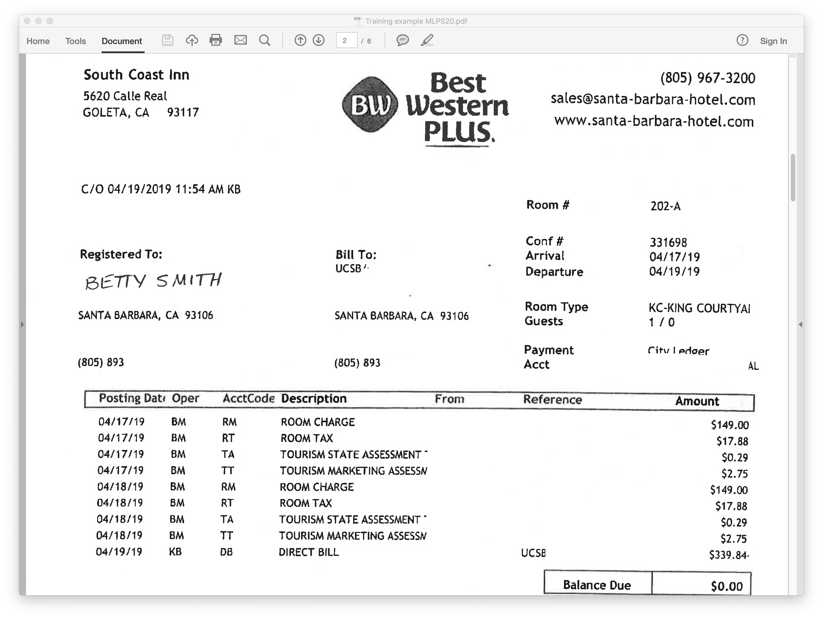
lodging…

Slide 21
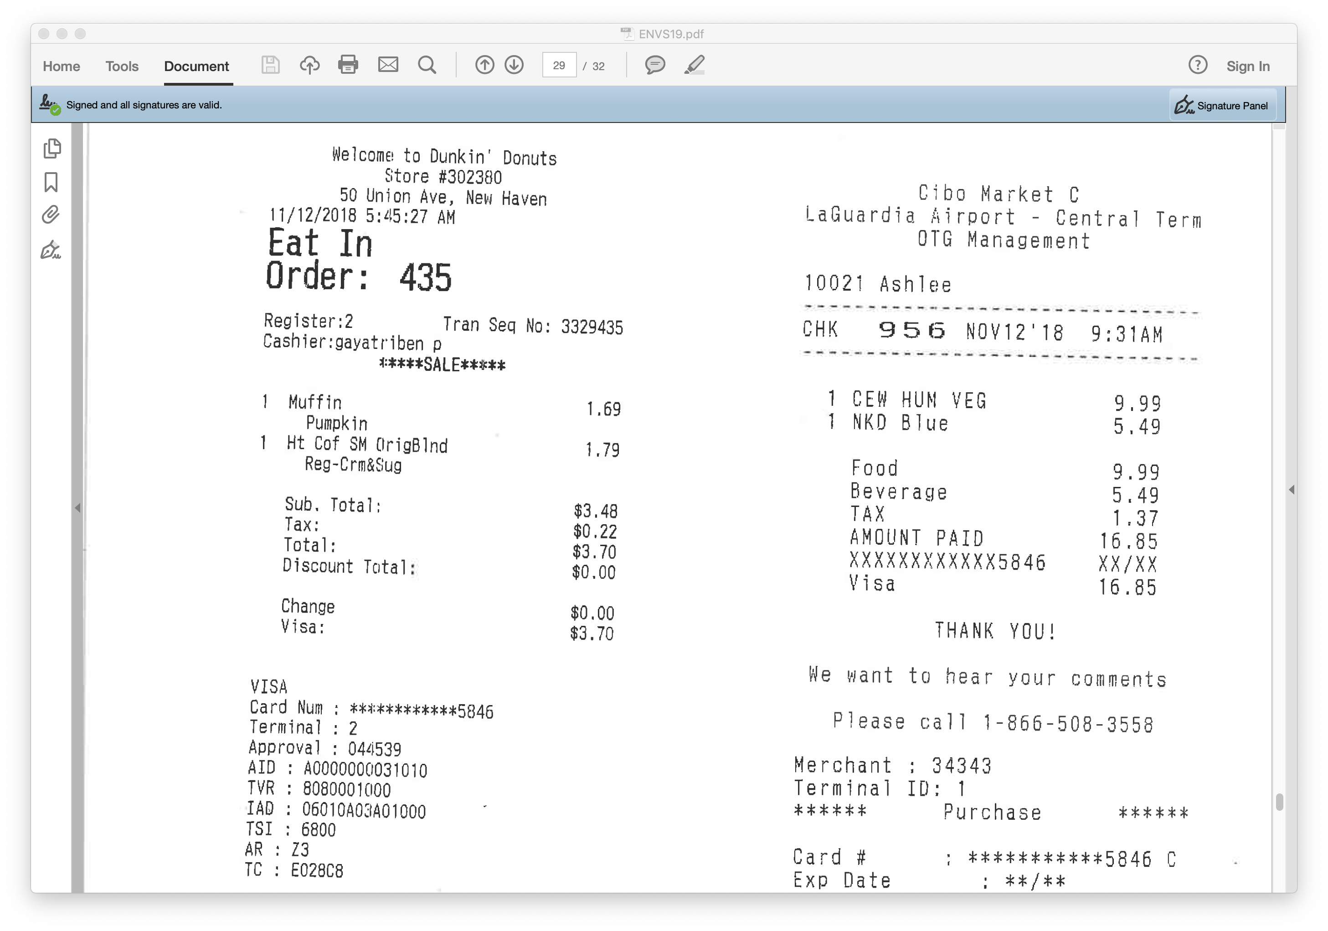
food in transit…

Slide 22
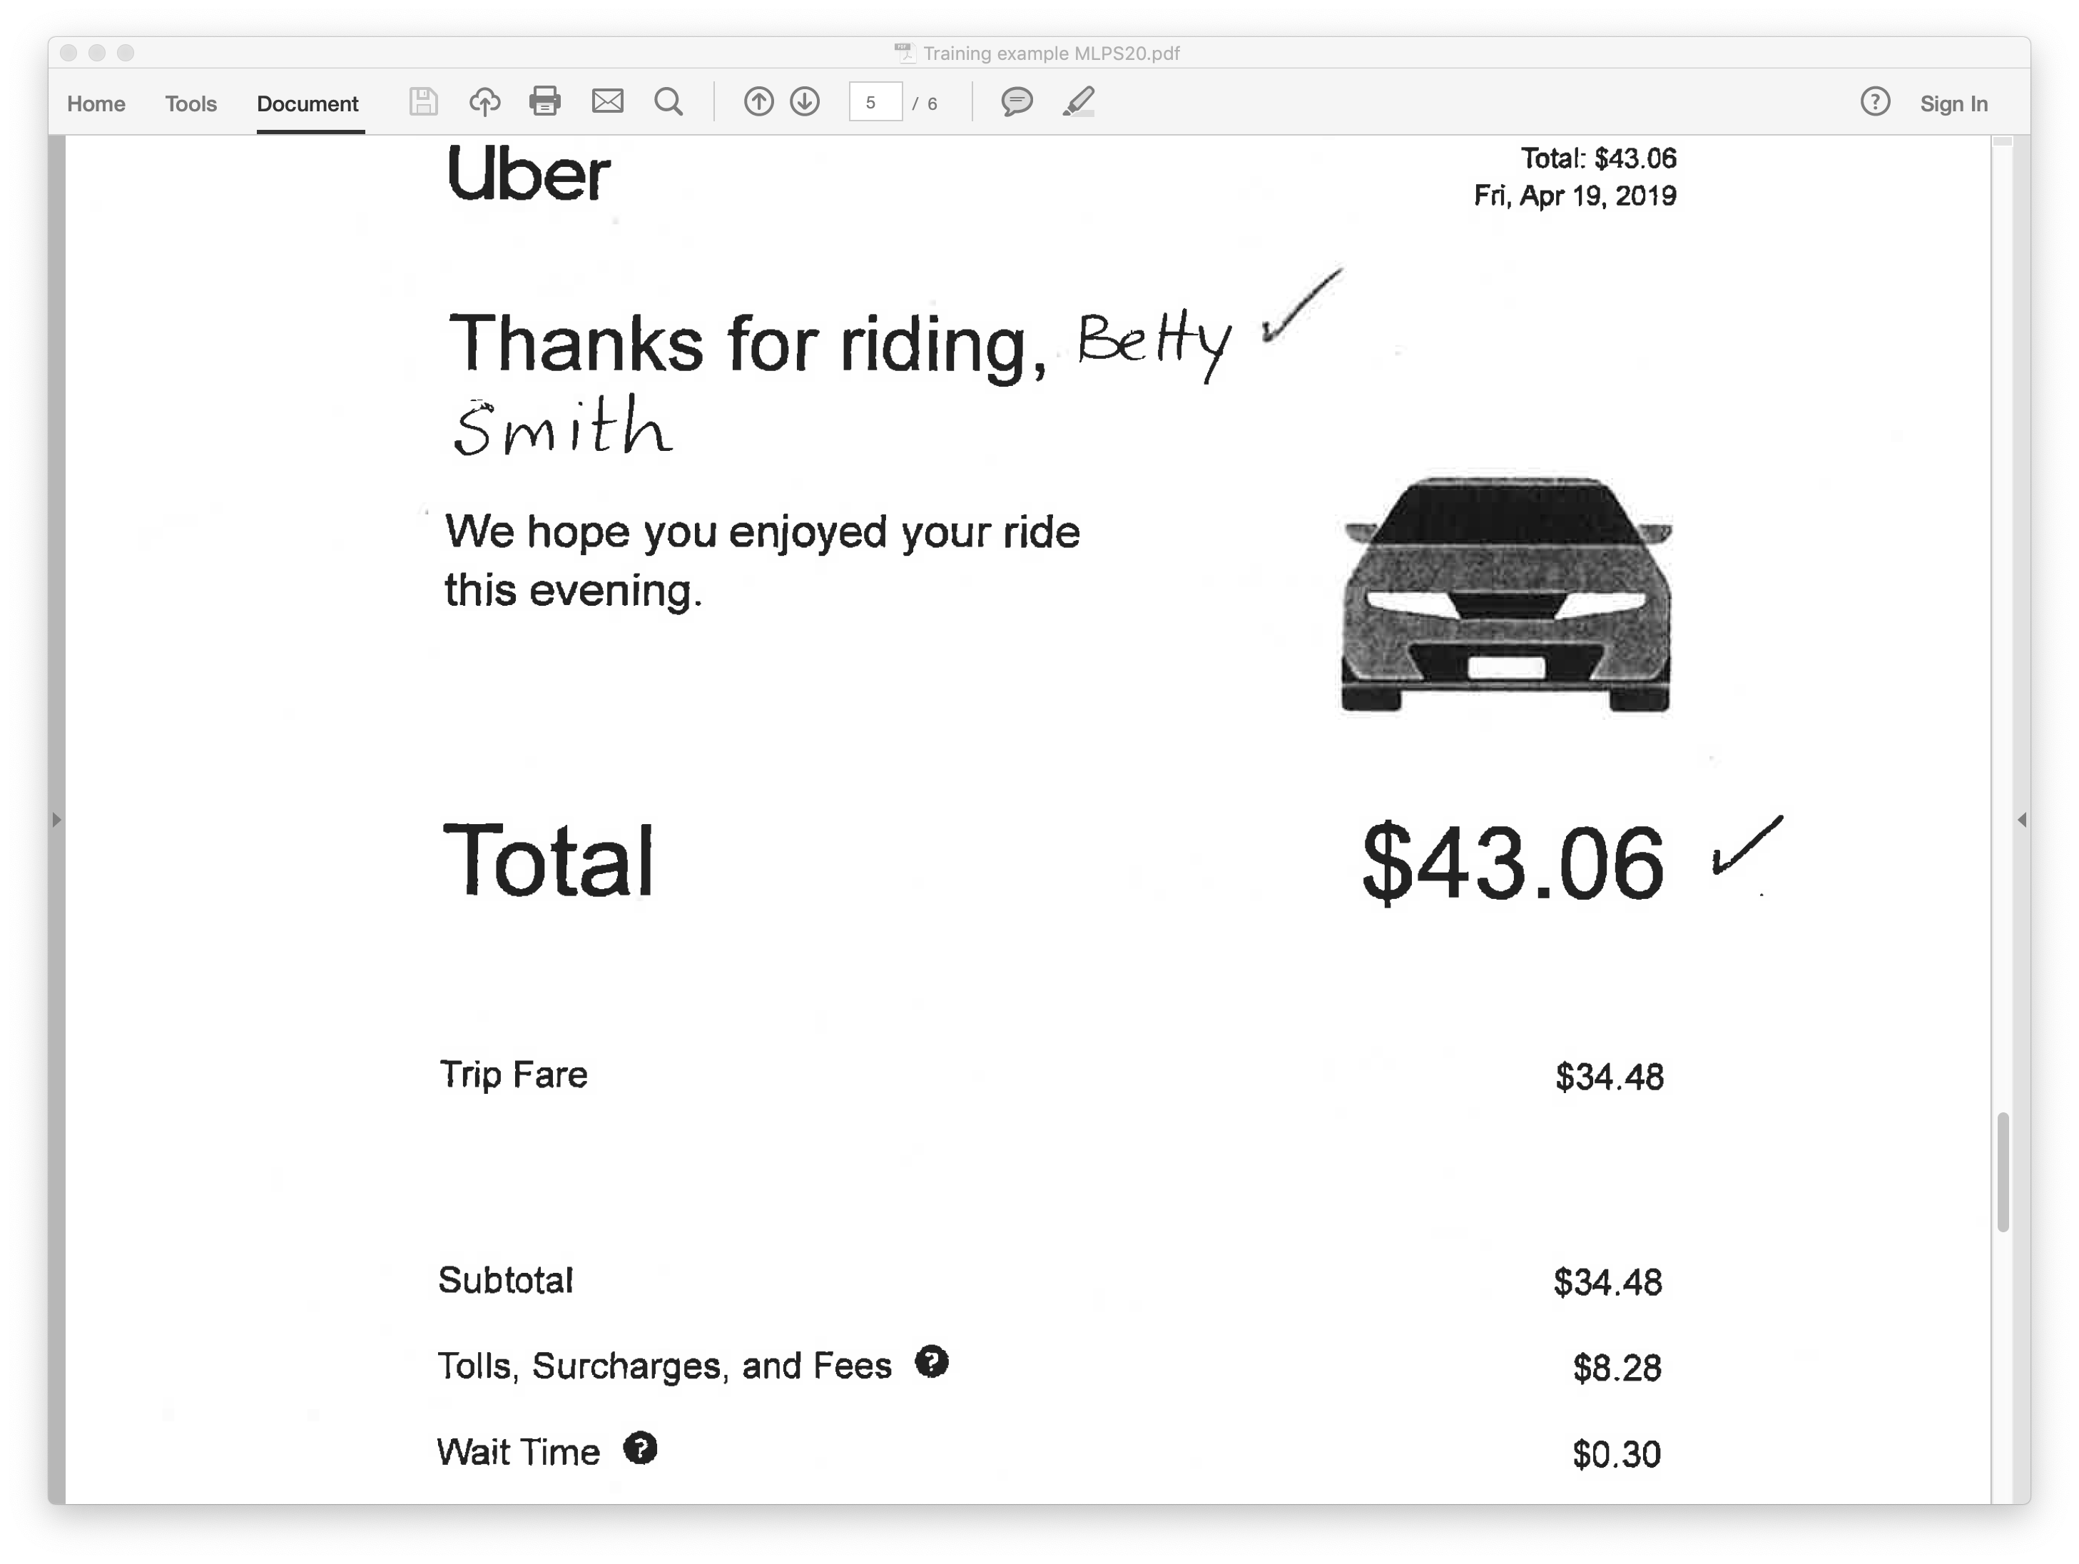
ground transportation…

Slide 23
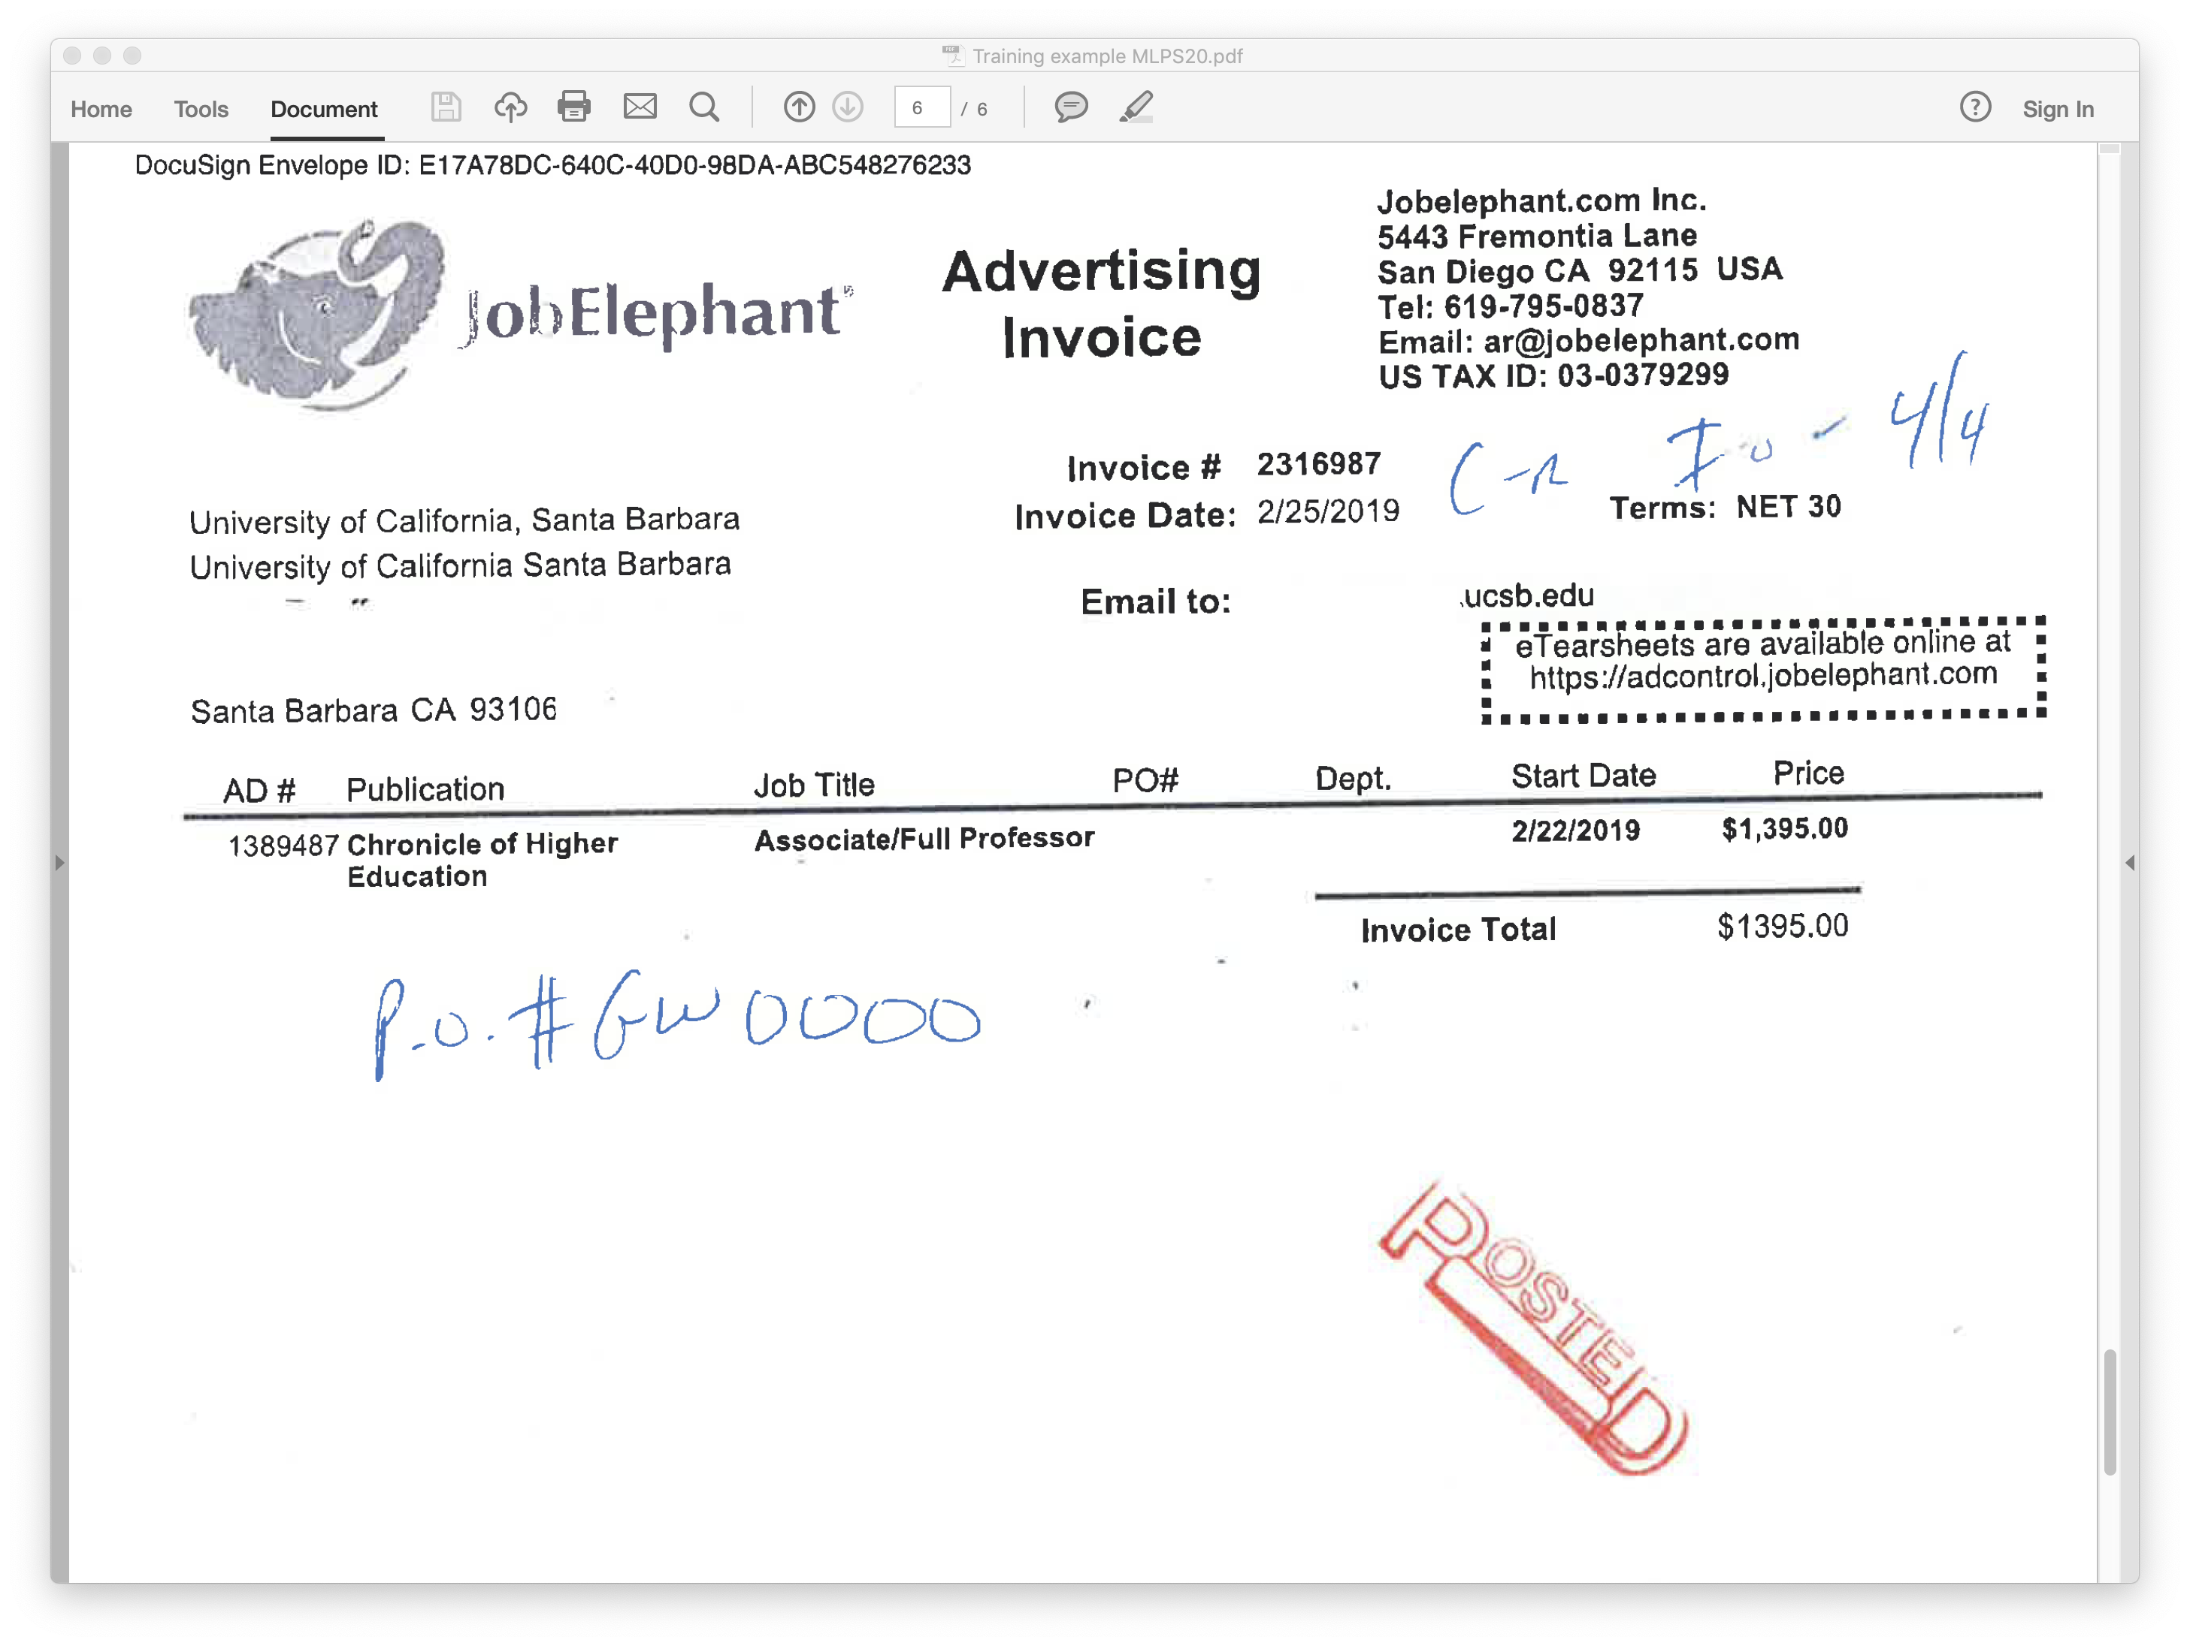
and advertising.

Slide 24
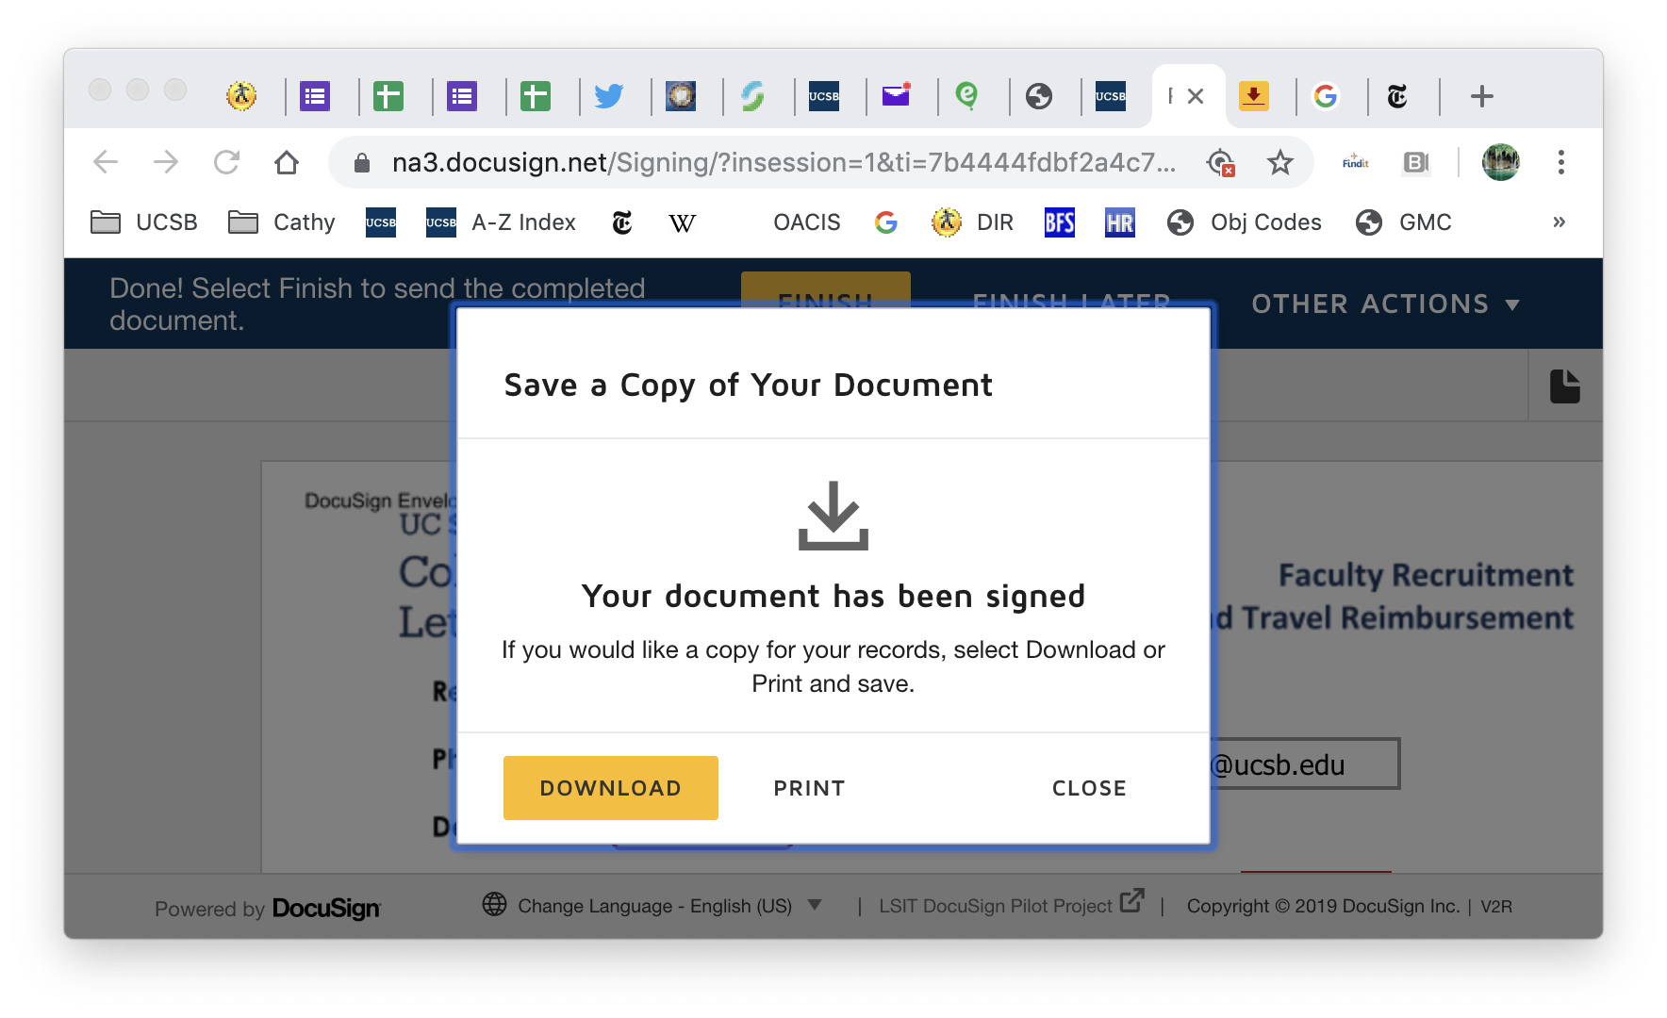
When all receipts are uploaded, click “done,” “finish,” and then either download or print your reimbursement file. Your request has now been submitted to the College, and your reimbursement will be sent via TOF to the account number you’ve indicated.

Slide 25
Any questions?
For more information about the reimbursement process, contact the College’s Assistant Dean for Administration, Alex Garcia, at x5289, malexgarcia@ucsb.edu (as of 12/20/19).

